Slide 1
Employee Data Analysis using Excel
STUDENT NAME: M. MADHAN KUMAR
REGISTER NO:312218462/A2B368BC2A4EF839ED14B3F32A0479B5
DEPARTMENT: B.COM-COMMERCE
COLLEGE : GOVERNMENT ARTS AND SCIENCE COLLEGE
PERUMBAKKAM.

Slide 2
PROJECT TITLE
Employee Performance Level Analysis using Excel

Slide 3


AGENDA
Problem Statement
Project Overview
End Users
Our Solution and Proposition
Dataset Description
Modelling Approach
Results and Discussion
Conclusion
3/21/2024 Annual Review

Slide 4

PROBLEM STATEMENT
This Statement was used for analysing the performance of the employee in the organisation.
This is done with the help of excel, it helps to make data-driven decisions to enhance productivity and recognize achievements, and the major point is to analyse the performance and develop the organisation in the top level.

Slide 5

PROJECT OVERVIEW
The project involves creating an Excel-based performance analysis system to assess and enhance employee effectiveness. Using Excel, we will collect and analyze performance data, identify patterns, and generate reports that highlight both individual and team performance. The goal is to provide actionable insights that can lead to better decision-making, targeted training, and improved organizational outcomes.

Slide 6

WHO ARE THE END USERS?
Employee
Employer
Organization
Firm

Slide 7

OUR SOLUTION AND ITS VALUE PROPOSITION
Filtering-Mining:
In Excel allows you to selectively display and analyze specific subsets of data based on criteria, enabling focused insights and streamlined data management.
Graphs-Visualisation:
In Excel help organize and manage data by allowing users to collapse or expand sections of related rows or columns, facilitating better data navigation and analysis.
Pivot Table-Summary
In Excel is a powerful tool that summarizes, analyzes, and presents large datasets by organizing data into rows, columns, and values for dynamic and interactive reporting.

Slide 8
Dataset Description
There are 26 features in this excel format, I take the 4 features using my project they are given below:
Business unit : "Business Unit," "Revenue," "Expenses," "Profit," and "Market Share" to clearly present and compare metrics for each unit.
Performance score : Conditional Formatting Apply conditional formatting to highlight high or low performance scores for better visualization.
Current employee rating : Number Format Ensure that the Rating column is formatted to show numbers or a rating scale if applicable.
Performance level gender :Create a summary table to analyze performance levels by gender. This table will help you visualize the data more effectively.

Slide 9

THE "WOW" IN OUR SOLUTION
THE “WOW” IN MY SOLUTION is I used in this excel sheet with the help of the method of formula method. It is used for filtering my data and gives the best performance level. So it will used for analysing the grade level and also it improves organisation’s growth.
3/21/2024 Annual Review
9

Slide 10
MODELLING
The Modelling of the data in my project, I have used in this data using the best Platform called (KAGGLE) in the EDUNET Dashboard. The following steps I made in my project,
Data Organization:
Start by structuring your data in a well-organized table, including essential fields such as Employee ID, Name, Gender, Department, Project ID, Performance Metrics, and Ratings.
Summary Tables:
Develop summary tables to aggregate data by projects and departments. This helps in understanding overall performance trends and making comparisons.
Visualization:
Utilize charts and graphs to visually represent performance data. Bar charts, pie charts, and line graphs can provide clear insights into how employees are performing across different projects and departments.
10

Slide 11
MODELLING:
Conditional Formatting: Apply conditional formatting to highlight key performance metrics and trends, making it easier to spot areas that need attention.
Interactive Elements: Incorporate slicers and other interactive elements to make your analysis more dynamic and user-friendly. This enables viewers to filter data based on different criteria and get customized insights.
Dashboard Creation: Compile your data, summaries, and visualizations into a cohesive dashboard. This dashboard should provide a comprehensive view of employee performance, helping stakeholders make informed decisions.
PivotTables: Leverage PivotTables for dynamic analysis, allowing you to easily slice and dice the data to reveal deeper insights and trends.

Slide 12
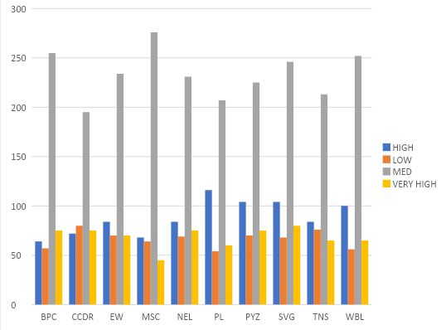
RESULT:
12

Slide 13
Conclusion
In summary, a comprehensive conclusion for a data analysis in a research study involves a strategic synthesis of key finding of the performance level of an each employee specifically and their implication, contribution to the organisations as a brief. I use the more options in this excel I get a best report related to my topic name of Employee Performance Level. This my conclusion.
3/21/2024 Annual Review

